Slide 1


Slide 2
Evangelists must be equipped to help seekers navigate the questions and obstacles to faith that uniquely characterize each individual.

Slide 3
Outline for Acts 17:16-34
Paul in Athens (16-21)
Paul’s Message on Mars Hill (22-31)
The Response to the Message (32-34)

Slide 4
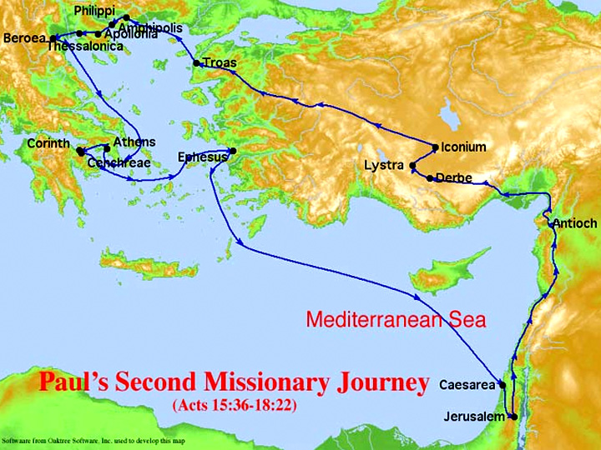

Slide 5
I. Paul in Athens (16-21)

Slide 6
The Stoics were pantheistic, i.e., they did not believe in a personal god. They believed that the universe, nature and God were one in the same. Pan = all (gr), theos = god (gr) – “All-god.”
The Epicureans maintained the existence of gods but claimed that they did not intervene in our daily life. Life was to be lived to the maximum pleasure and experience, for once one died it was OVER.

Slide 7
II. The Message on Mars Hill (22-31)

Slide 8
What did he say?
• Men are seekers, seeking divinity (23)
• The need for and desire to “worship” (23)
• God (singular) “made the world” (24)
• He is Lord of all (24)
• He is not confined or limited to the physical (24)
• He is self-sufficient & self-existent
• He is spiritual (non physical) (25)
• He is the giver, author & sustainer of life (25)

Slide 9
What did he say?
• He is the Creator and has declared boundaries in man’s life (26)
• He has a WILL (26)
• It is His will that man “seek” Him (27)
• He is near (27)
• He is Creator, Sustainer, Provider (28)
• Man is made in God’s image (28, 29)
• We did not create God (29

Slide 10
What did he say?
• He is superior in intelligence (30)
• He has moral expectations (30)
• Judgment is coming and He is in charge (31)
• He will “judge” (31)
• He is righteous and has set the Standard (31)
• Ordained = ordered (31)

Slide 11
III. The Response to the Message (32-34)

Slide 12
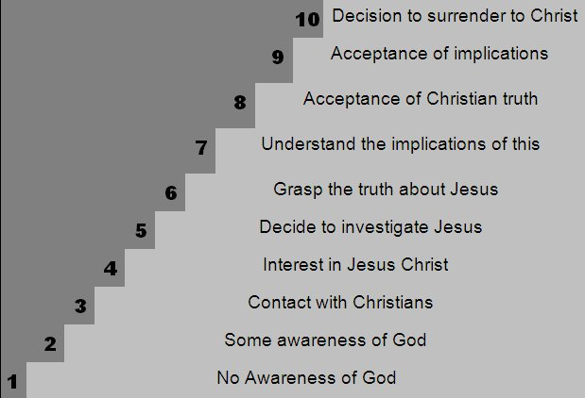

Slide 13
We must realize:
• Man was born to worship
• God always makes the first move
• God uses people to reach people
• Like Paul we ought to be troubled by the wholesale idolatry
• As biblical literacy declines we must retreat to the basics to help others understand

Slide 14
We must realize:
• It is our responsibility to move people closer
• It is our responsibility to answer the tough questions – be prepared
• One size does NOT fit all
• People need “truth,” “hope” and “love”
• There will be a wide variety of responses
• Conversion is the responsibility of the Spirit of God

